Slide 1
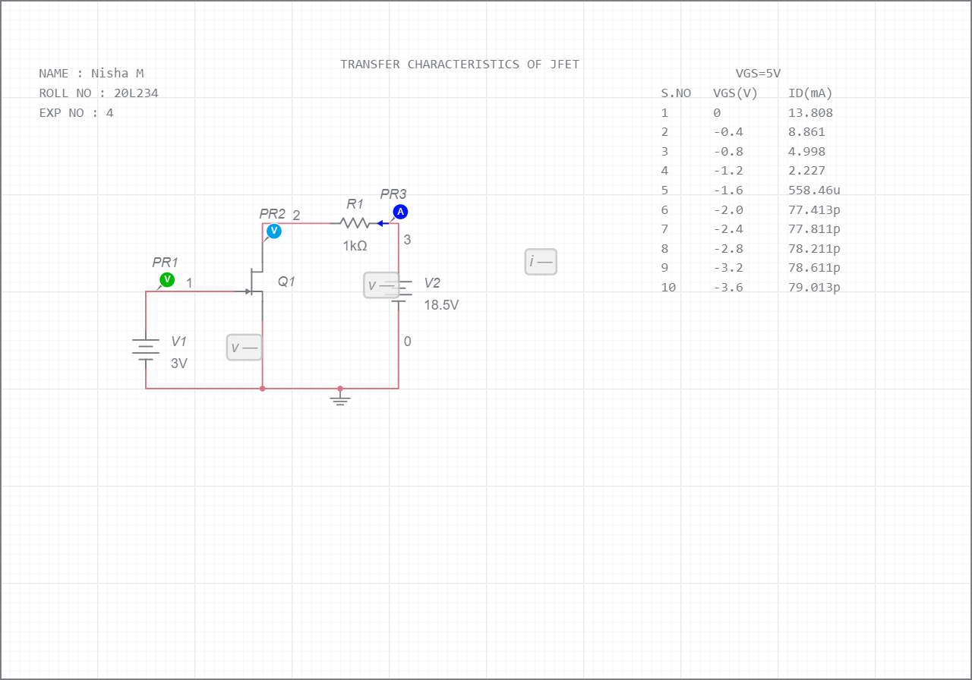
Paris is beautiful place
1

Slide 2
he is narrating a story

